Slide 1
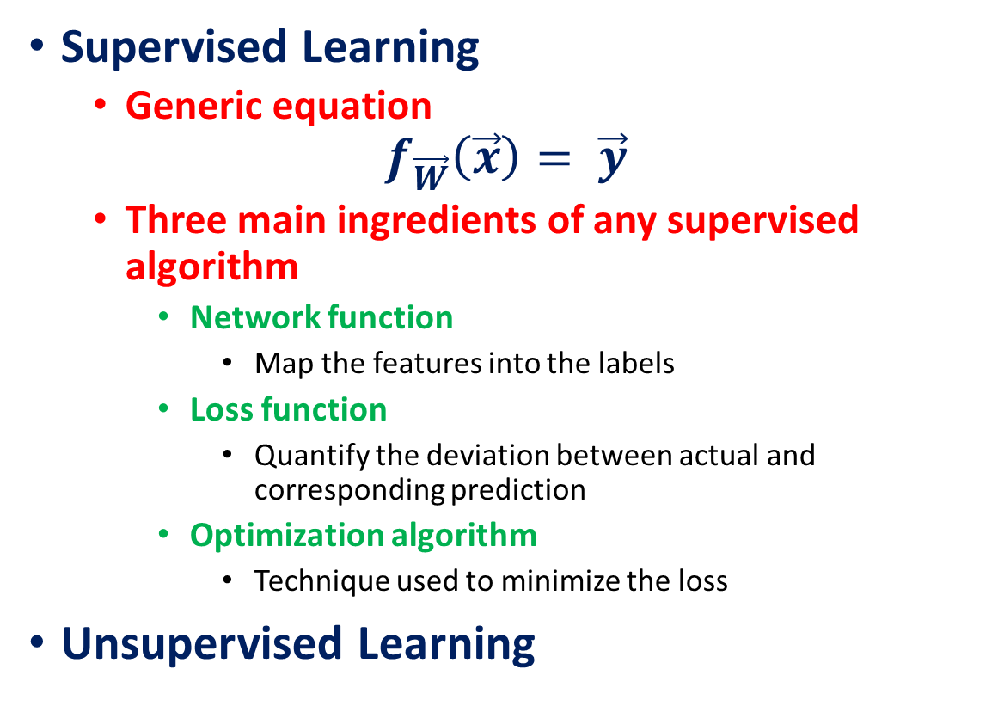
Classical machine learning algorithms
Supervised Learning
Generic equation
$$f_{\vec{W}}\left(\vec{x}\right)= \vec{y}$$
Three main ingredients of any supervised algorithm
Network function
Map the features into the labels
Loss function
Quantify the deviation between actual and corresponding prediction
Optimization algorithm
Technique used to minimize the loss
Unsupervised Learning

Slide 2
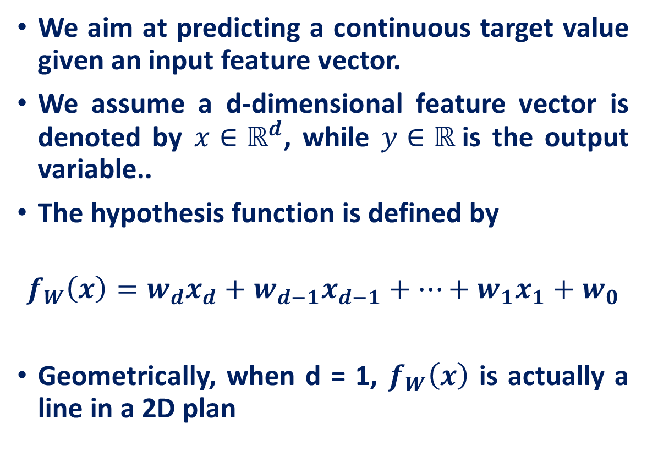
Linear Regression
We aim at predicting a continuous target value given an input feature vector.
We assume a d-dimensional feature vector is denoted by $x∈ℝ^{d}$, while $y∈ℝ$is the output variable..
The hypothesis function is defined by
$$f_{W}\left(x\right)=w_{d}x_{d}+w_{d−1}x_{d−1}+…+w_{1}x_{1}+w_{0}$$
Geometrically, when d = 1, $f_{W}\left(x\right)$ is actually a line in a 2D plan

Slide 3
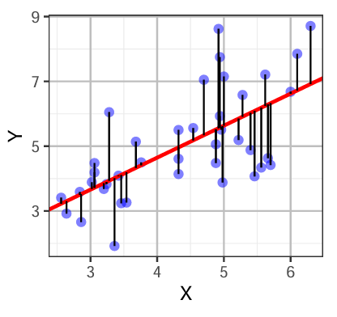

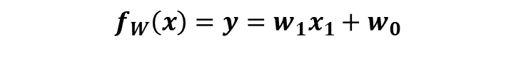
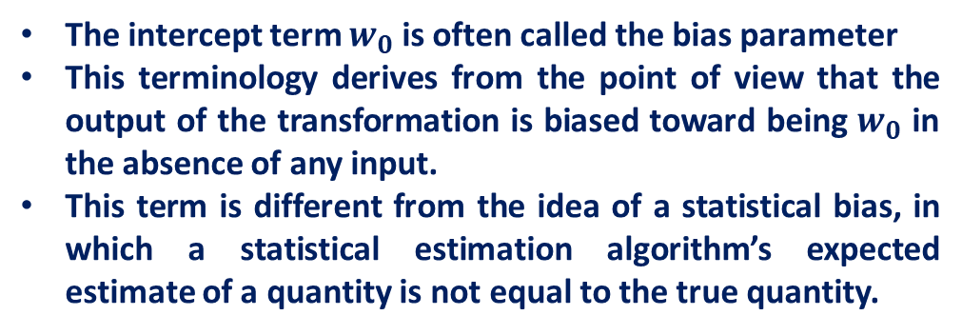
Linear Regression
$$f_{W}\left(x\right)=y=w_{1}x_{1}+w_{0}$$
Slope
Intercept
The intercept term $w_{0}$ is often called the bias parameter
This terminology derives from the point of view that the output of the transformation is biased toward being $w_{0}$ in the absence of any input.
This term is different from the idea of a statistical bias, in which a statistical estimation algorithm’s expected estimate of a quantity is not equal to the true quantity.
$$w_{o}$$

Slide 4
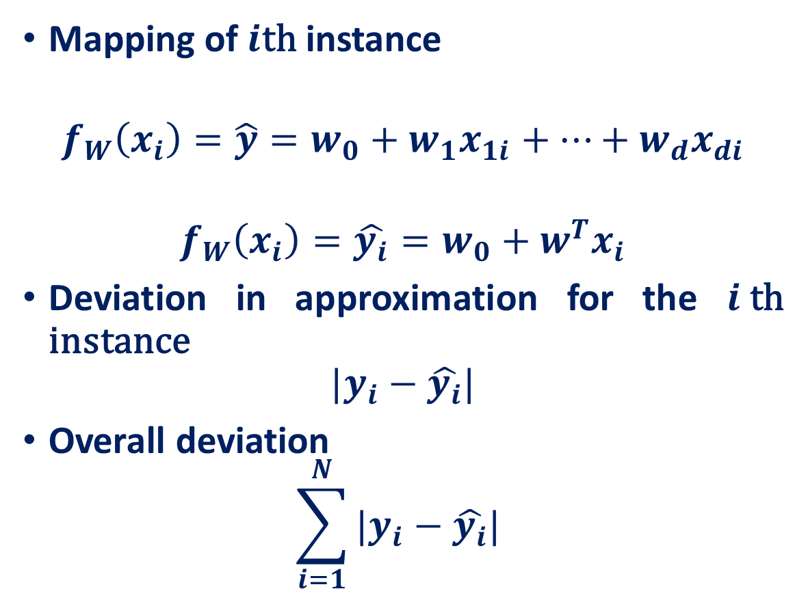
Optimization: Linear Regression
Mapping of $i$th instance
$$f_{W}\left(x_{i}\right)=\hat{y}=w_{0}+w_{1}x_{1i}+…+w_{d}x_{di}$$
$$f_{W}\left(x_{i}\right)=\hat{y_{i}}=w_{0}+w^{T}x_{i}$$
Deviation in approximation for the $i$th instance
$$|y_{i}−\hat{y_{i}}|$$
Overall deviation
$$\sum_{i=1}^{N}{|y_{i}−\hat{y_{i}}| }$$

Slide 5
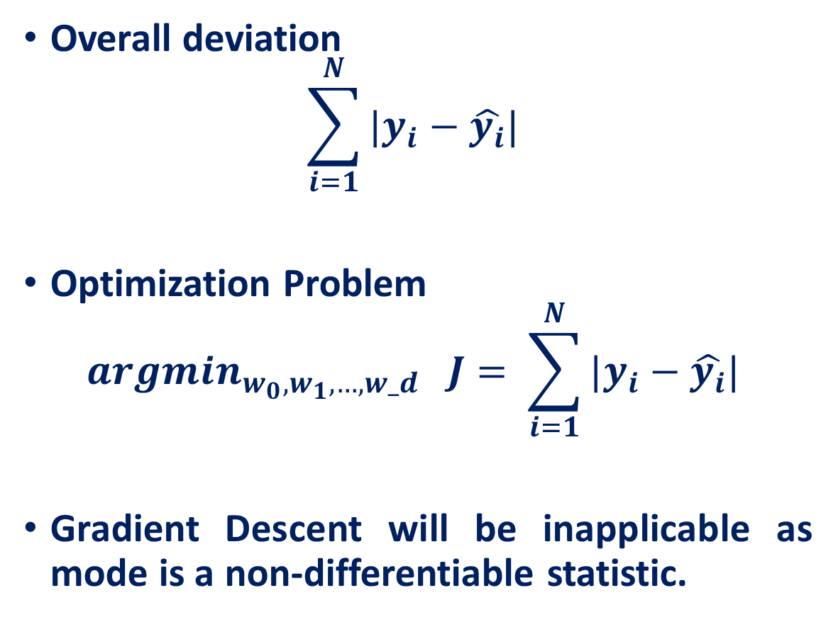
Optimization: Linear Regression
Overall deviation
$$\sum_{i=1}^{N}{|y_{i}−\hat{y_{i}}| }$$
Optimization Problem
$${argmin}_{w_{0}, w_{1},…,w_d} J= \sum_{i=1}^{N}{|y_{i}−\hat{y_{i}}| }$$
Gradient Descent will be inapplicable as mode is a non-differentiable statistic.

Slide 6
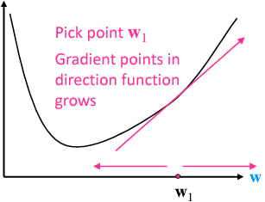

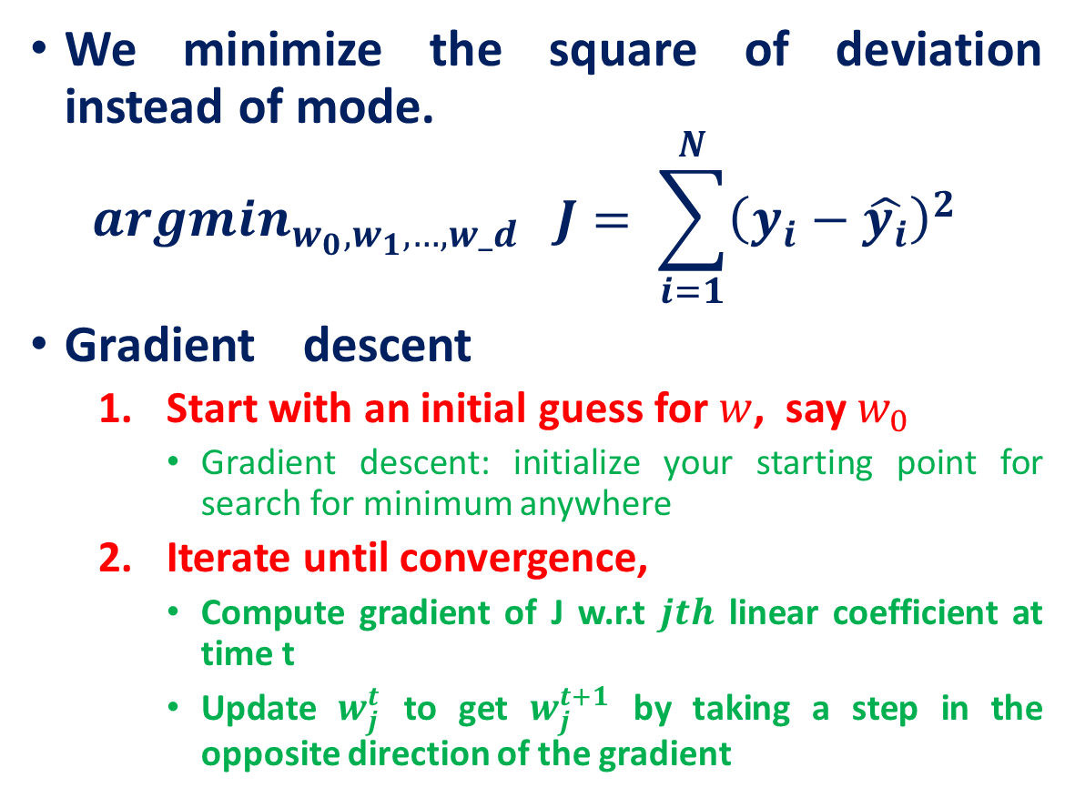
Optimization: Linear Regression
We minimize the square of deviation instead of mode.
$${argmin}_{w_{0}, w_{1},…,w_d} J= \sum_{i=1}^{N}{{\left(y_{i}−\hat{y_{i}}\right)}^{2} }$$
Gradient descent
Start with an initial guess for $w$, say $w_{0}$
Gradient descent: initialize your starting point for search for minimum anywhere
Iterate until convergence,
Compute gradient of J w.r.t $jth$ linear coefficient at time t
Update $w_{j}^{t}$ to get $w_{j}^{t+1}$ by taking a step in the opposite direction of the gradient
J
And eventually you will get to minimum

Slide 7

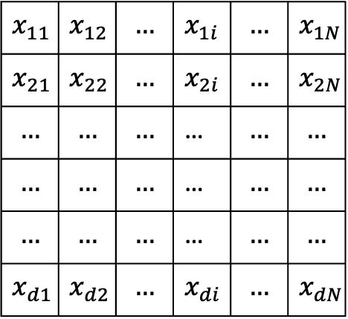

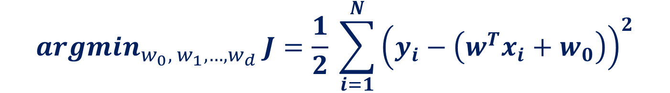






Optimization: Linear Regression
$${argmin}_{w_{0}, w_{1}, …, w_{d}} J=\frac{1}{2} \sum_{i=1}^{N}{{\left(y_{i}−\left(w^{T}x_{i}+w_{0}\right)\right)}^{2}}$$
$$T$$
$$x_{11}$$ | $$x_{12}$$ | $$…$$ | $$x_{1i}$$ | $$…$$ | $$x_{1N}$$
$$x_{21}$$ | $$x_{22}$$ | $$…$$ | $$x_{2i}$$ | $$…$$ | $$x_{2N}$$
$$…$$ | $$…$$ | $$…$$ | … | $$…$$ | $$…$$
$$…$$ | $$…$$ | $$…$$ | … | $$…$$ | $$…$$
$$…$$ | $$…$$ | $$…$$ | … | $$…$$ | $$…$$
$$x_{d1}$$ | $$x_{d2}$$ | $$…$$ | $$x_{di}$$ | $$…$$ | $$x_{dN}$$
$$x_{1i}$$
$$x_{2i}$$
…
…
…
$$x_{di}$$
$$x_{1i}$$
$$x_{2i}$$
…
…
…
$$x_{di}$$
$$w_{1}$$
$$w_{2}$$
…
…
…
$$w_{d}$$
$$\hat{y_{i}}=$$
$$×$$
$$+ w_{0}$$
$$X∈ℝ^{d×N}$$

Slide 8

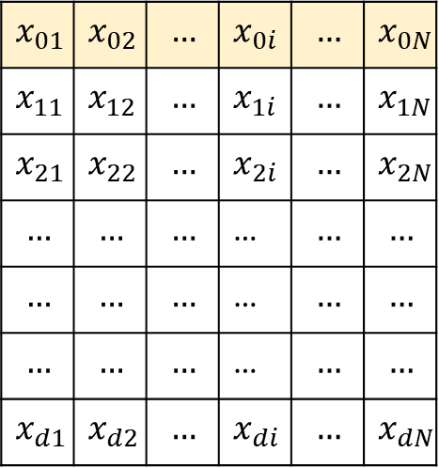
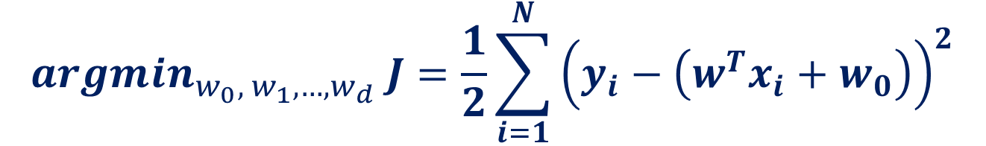



Optimization: Linear Regression
$${argmin}_{w_{0}, w_{1}, …, w_{d}} J=\frac{1}{2}\sum_{i=1}^{N}{{\left(y_{i}−\left(w^{T}x_{i}+w_{0}\right)\right)}^{2}}$$
$$T$$
$$T$$
$$x_{11}$$ | $$x_{12}$$ | $$…$$ | $$x_{1i}$$ | $$…$$ | $$x_{1N}$$
$$x_{21}$$ | $$x_{22}$$ | $$…$$ | $$x_{2i}$$ | $$…$$ | $$x_{2N}$$
$$…$$ | $$…$$ | $$…$$ | … | $$…$$ | $$…$$
$$…$$ | $$…$$ | $$…$$ | … | $$…$$ | $$…$$
$$…$$ | $$…$$ | $$…$$ | … | $$…$$ | $$…$$
$$x_{d1}$$ | $$x_{d2}$$ | $$…$$ | $$x_{di}$$ | $$…$$ | $$x_{dN}$$
$$x_{01}$$ | $$x_{02}$$ | $$…$$ | $$x_{0i}$$ | $$…$$ | $$x_{0N}$$
$$x_{11}$$ | $$x_{12}$$ | $$…$$ | $$x_{1i}$$ | $$…$$ | $$x_{1N}$$
$$x_{21}$$ | $$x_{22}$$ | $$…$$ | $$x_{2i}$$ | $$…$$ | $$x_{2N}$$
$$…$$ | $$…$$ | $$…$$ | … | $$…$$ | $$…$$
$$…$$ | $$…$$ | $$…$$ | … | $$…$$ | $$…$$
$$…$$ | $$…$$ | $$…$$ | … | $$…$$ | $$…$$
$$x_{d1}$$ | $$x_{d2}$$ | $$…$$ | $$x_{di}$$ | $$…$$ | $$x_{dN}$$
$$x_{1i}$$
$$x_{2i}$$
…
…
…
$$x_{di}$$
$$w_{0}$$
$$w_{1}$$
$$w_{2}$$
…
…
…
$$w_{d}$$
$$1$$
$$x_{1i}$$
$$x_{2i}$$
…
…
…
$$x_{di}$$
$$\hat{y_{i}}=$$
$$×$$
$$X∈ℝ^{d×N}$$

Slide 9
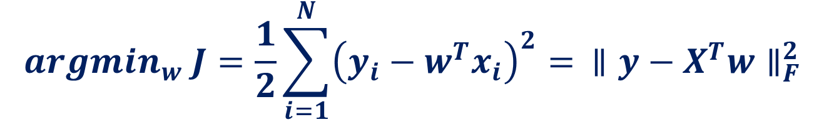
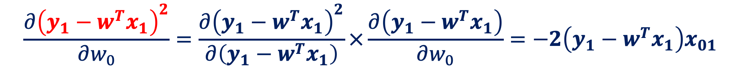
Optimization: Linear Regression
$${argmin}_{w} J=\frac{1}{2}\sum_{i=1}^{N}{{\left(y_{i}−w^{T}x_{i}\right)}^{2}}= ∥y−X^{T}w∥_{F}^{2}$$
$${argmin}_{w} J=\frac{1}{2}\left[{\left(y_{1}−w^{T}x_{1}\right)}^{2}+{\left(y_{2}−w^{T}x_{2}\right)}^{2}+…+{\left(y_{N}−w^{T}x_{N}\right)}^{2}\right]$$
$$\frac{∂{\left(y_{1}−w^{T}x_{1}\right)}^{2}}{∂w_{0}}=\frac{∂{\left(y_{1}−w^{T}x_{1}\right)}^{2}}{∂\left(y_{1}−w^{T}x_{1}\right)}×\frac{∂\left(y_{1}−w^{T}x_{1}\right)}{∂w_{0}}=−2\left(y_{1}−w^{T}x_{1}\right)x_{01}$$

Slide 10
Optimization: Linear Regression
$${argmin}_{w} J=\frac{1}{2}\left[{\left(y_{1}−w^{T}x_{1}\right)}^{2}+{\left(y_{2}−w^{T}x_{2}\right)}^{2}+…+{\left(y_{N}−w^{T}x_{N}\right)}^{2}\right]$$
$$\frac{∂{\left(y_{1}−w^{T}x_{1}\right)}^{2}}{∂w_{0}}=\frac{∂{\left(y_{1}−w^{T}x_{1}\right)}^{2}}{∂\left(y_{1}−w^{T}x_{1}\right)}×\frac{∂\left(y_{1}−w^{T}x_{1}\right)}{∂w_{0}}=−2\left(y_{1}−w^{T}x_{1}\right)x_{01}$$
$$\frac{∂J}{∂w_{0}}=\frac{1}{2}\left[−2\left(y_{1}−w^{T}x_{1}\right)x_{01}−2\left(y_{2}−w^{T}x_{2}\right)x_{02}−…−2\left(y_{N}−w^{T}x_{N}\right)x_{0N}\right]$$

Slide 11




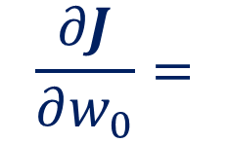



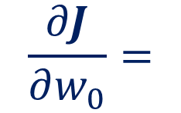



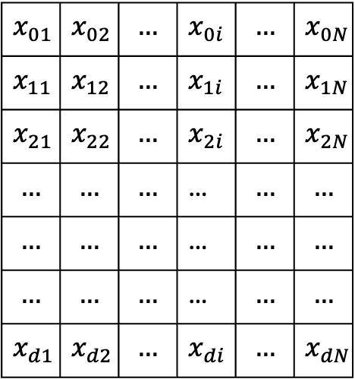


Optimization: Linear Regression
$$\frac{∂J}{∂w_{0}}=−\left[\left(y_{1}−w^{T}x_{1}\right)x_{01}+\left(y_{2}−w^{T}x_{2}\right)x_{02}+…+2\left(y_{N}−w^{T}x_{N}\right)x_{0N}\right]$$
$$T$$
$$y_{1}$$
$$y_{2}$$
$$…$$
$$…$$
$$…$$
$$y_{N}$$
$$x_{01}$$ | $$x_{02}$$ | $$…$$ | $$x_{0i}$$ | $$…$$ | $$x_{0N}$$
$$x_{11}$$ | $$x_{12}$$ | $$…$$ | $$x_{1i}$$ | $$…$$ | $$x_{1N}$$
$$x_{21}$$ | $$x_{22}$$ | $$…$$ | $$x_{2i}$$ | $$…$$ | $$x_{2N}$$
$$…$$ | $$…$$ | $$…$$ | … | $$…$$ | $$…$$
$$…$$ | $$…$$ | $$…$$ | … | $$…$$ | $$…$$
$$…$$ | $$…$$ | $$…$$ | … | $$…$$ | $$…$$
$$x_{d1}$$ | $$x_{d2}$$ | $$…$$ | $$x_{di}$$ | $$…$$ | $$x_{dN}$$
$$w_{0}$$
$$w_{1}$$
$$w_{2}$$
…
…
…
$$w_{d}$$
$$\frac{∂J}{∂w_{0}}=$$
$$−$$
$$x_{01}$$ | $$x_{02}$$ | $$…$$ | $$x_{0i}$$ | $$…$$ | $$x_{0N}$$
$$×$$
$$−$$
$$×$$
$$\frac{∂J}{∂w_{0}}=$$
$$−$$
$$X_{0}.$$
$$×$$
$$\left(y−X^{T}w\right)$$

Slide 12
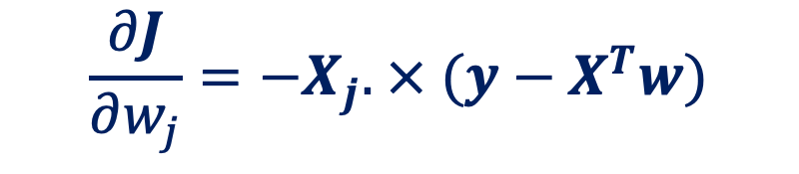
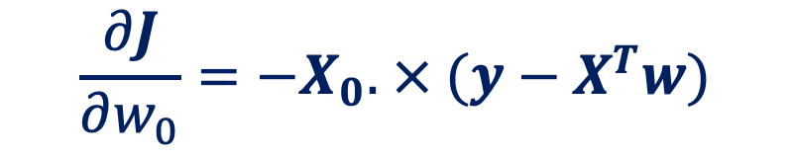
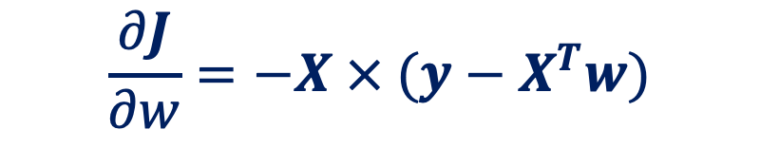
Optimization: Linear Regression
$$\frac{∂J}{∂w_{0}}=−X_{0}. × (y−X^{T}w)$$
$$\frac{∂J}{∂w_{j}}=−X_{j}. × (y−X^{T}w)$$
$$\frac{∂J}{∂w}=−X × (y−X^{T}w)$$

Slide 13
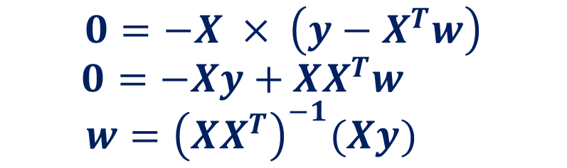
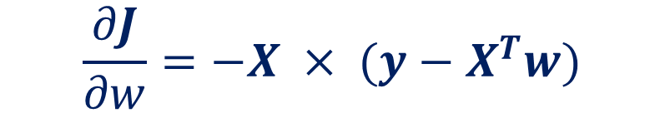
Optimization: Closed form Solution
At the point of minimization, the gradient of the loss function with respect to the model parameters is zero, indicating that the best fit has been found.
$$\frac{∂J}{∂w}=−X × (y−X^{T}w)$$
$$0=−X × \left(y−X^{T}w\right)$$
$$0=−Xy+XX^{T}w$$
$$w={\left(XX^{T}\right)}^{−1}(Xy)$$

Slide 14
References
Lecture 2: Deep Learning Fundamentals by Serena Yeung

